Slide 1
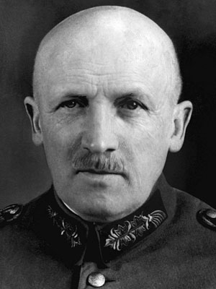
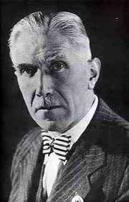
Kurt Von Schleicher & Franz von Papen
Hitler’s unwitting enablers.

Slide 2
Kurt von Schleicher was the head of the army’s political bureau in 1929, Defence Minister in 1930 and Chancellor in 1932-33.
He was seen as a secretive manipulator and believed in establishing a authoritarian Presidential regime backed by a strong army.
Hitler’s sharp rise in popularity in 1930 saw Schleicher intensify his efforts to win his support.
He believed that it was necessary to cooperate with the Nazi’s to achieve his aims.

Slide 3
In early 1932, while Defence Minister, Schleicher approached Hitler with the view to secure his support in a change of government.
Hitler demanded that fresh elections be called and a ban that existed against his SA paramilitary wing be lifted.
Schleicher, confident that he could control Hitler and the Nazis, agreed to his terms.
Through the use of malicious rumormongering and back room dealing Schleicher forced Bruning to resign as Chancellor on 30 May, 1932.
Franz von Papen was recommended as a replacement as leader of the Reichstag.

Slide 4
Franz von Papen was an associate of Schleicher who had been approached about the position only a few days before Brunings resignation.
He was a politician without a party when he was appointed as Chancellor on 31 May, 1932.
He was to govern without a parliamentary majority and had to rely on Presidential decrees and the toleration of the Nazis.

Slide 5
The nature of Papens position was made clear in a exchange between Schleicher and another minister: The minister said to Schleicher that Papen had no “head” for politics. Schleicher replied “He doesn’t need a head. His job is to be a hat”.
Schleicher and Papen planned to manipulate the growing Nazi party to formulate their own system of government. They were still confident that they could control Hitler.
On June 16 they followed through on their promise to Hitler and lifted the ban on the SA. This would be another serious miscalculation.

Slide 6
By early 1933 the Reichstag had effectively ceased to function. Successive Chancellors had to rely executive powers to pass legislation due to the inability of any party to gain a majority.
Rifts began to appear between the equally ambitious Schleicher and Papen.
In an attempt to see off his rival, Papen hatched a plan to persuade President Hindenburg to install Hitler as Chancellor and him as Vice Chancellor.
He argued that power would serve as a motivation for Hitler to moderate his policies.
Hitler was installed as Chancellor on 30 January 1933.
Papen would not have to wait long to realise how wrong he was.

